Slide 1


Mentor Mentee Web Application (MENTORING)
PRESENTED BY:-
Saumya Agrahari (2103420100092)
Sejal Rai (2103420100093)
Shuchita Das (2103420100106)
Vaishnavi Mishra (2103420100117)

Slide 2

Topics Covered
Introduction
Methodology
Flowchart
DFD
Results/Snapshots
Limitations
Future Scope
References

Slide 3
Introduction
Mentoring websites play a pivotal role in course selection by connecting individuals with experienced mentors who provide personalized guidance based on interests, strengths, and career aspirations. Mentors offer insights into course relevance, industry demand, and career prospects, helping users align their goals with the right educational paths.
Our mentor web application aims to create a dynamic platform that fosters meaningful mentor-mentee connections, enabling personalized guidance for professional growth. By promoting knowledge sharing, career development, and informed decision-making, we empower users to achieve their educational and career aspirations while continuously improving through user feedback.

Slide 4
Need For Mentoring Application
Guidance in Career and Education
Individuals often struggle to choose the right courses, careers, or skill-development pathways.
Access to Expertise
Offers mentees access to industry experts and professionals who share valuable insights, knowledge, and real-world experiences.
Building Professional Networks
Facilitates meaningful connections that go beyond mentorship, fostering long-term professional relationships.
Structured Mentorship Process
Provides a centralized and organized platform for seamless communication, scheduling, and progress tracking.
Bridging Skill Gaps
Helps individuals identify and address skill gaps based on their career aspirations and industry demands.

Slide 5
Literature Review
Traditional mentorship systems often face numerous challenges that hinder their effectiveness and accessibility. In many cases, mentorship programs are either manual or semi-automated, resulting in inefficiencies, poor engagement, and mismatched expectations between mentors and mentees.
As a result, mentees often struggle to find the right mentors, and mentors may find it difficult to track the progress of their mentees effectively. Additionally, many existing systems do not offer the ability to schedule sessions, make bookings in advance, or integrate with modern technologies like mobile applications and cloud databases.
The Mentoring web application is designed to address these issues by leveraging modern web technologies to provide an intelligent, automated, and user-friendly platform for both mentors and mentees.

Slide 6
Methodology
Needs Assessment
Conduct research via surveys, interviews, and market analysis to identify user challenges in career decision-making.
Understand target audience demographics, preferences, and pain points.
Platform Design
Develop a user-centric interface with intuitive navigation, accessibility, and seamless usability.
Focus on responsive design for accessibility across devices.
Matching Algorithm
Implement a robust algorithm to match mentees with mentors based on industry expertise, experience, and compatibility criteria.
Communication Tools
Integrate features like messaging, video calls, and discussion forums for seamless mentor-mentee interaction.
Add scheduling tools to plan mentorship sessions and track progress.
Resource Hub
Build a centralized repository offering curated articles, videos, and online courses from trusted sources.

Slide 7
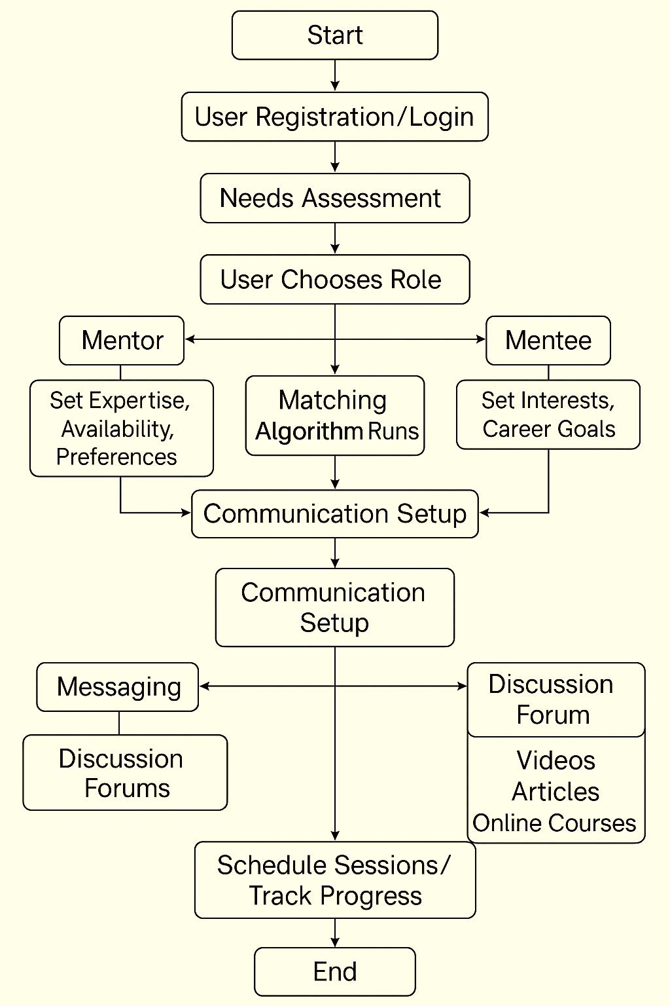
Flowchart
Login
Mentor Allocation

Slide 8
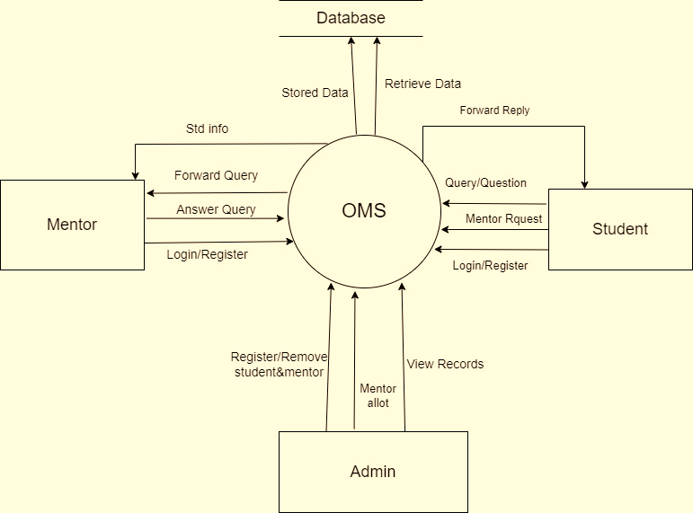

DFD
Add here

Slide 9
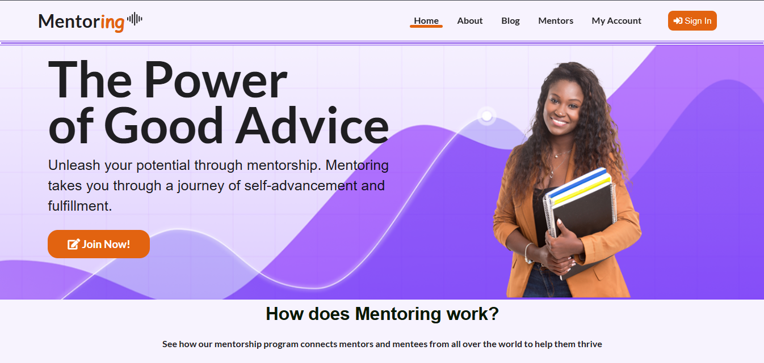
Results / Snapshots
Home Page

Slide 10
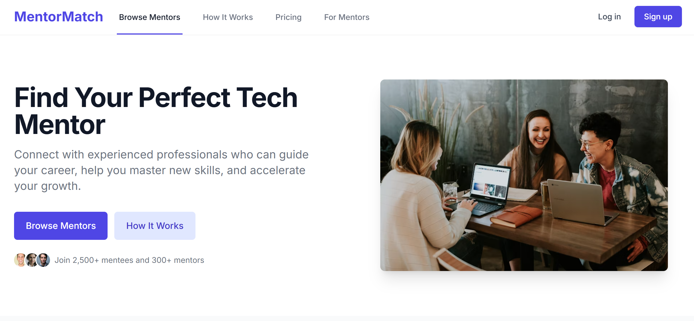
Results / Snapshots
Home Page

Slide 11
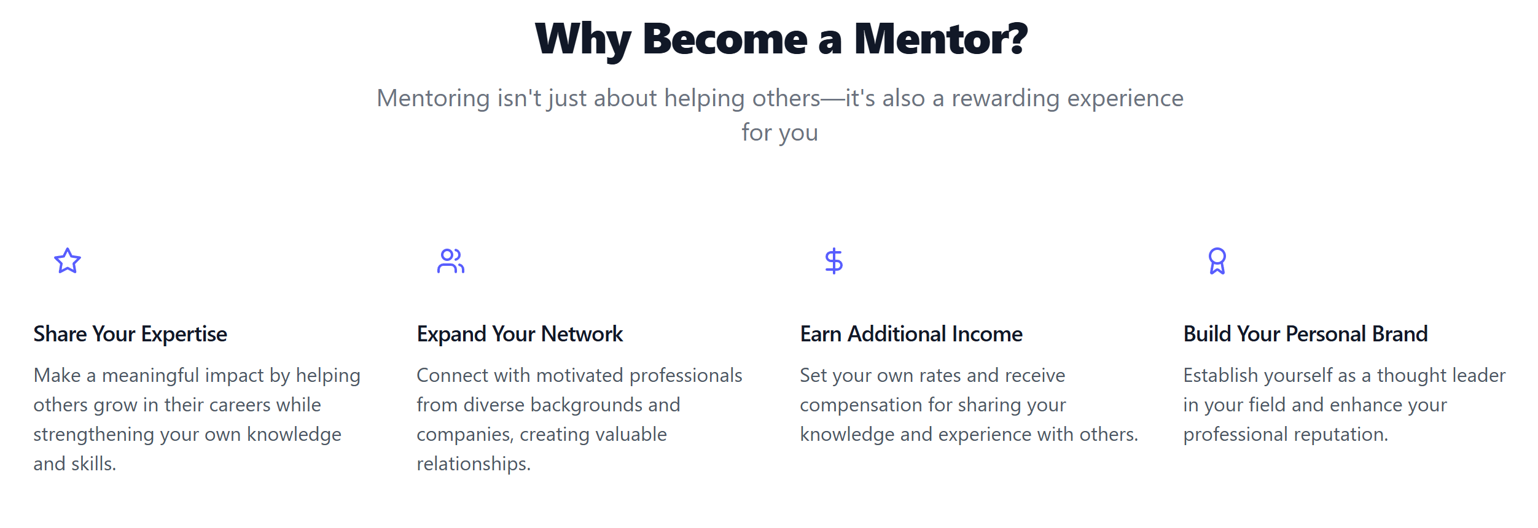
Results / Snapshots

Slide 12
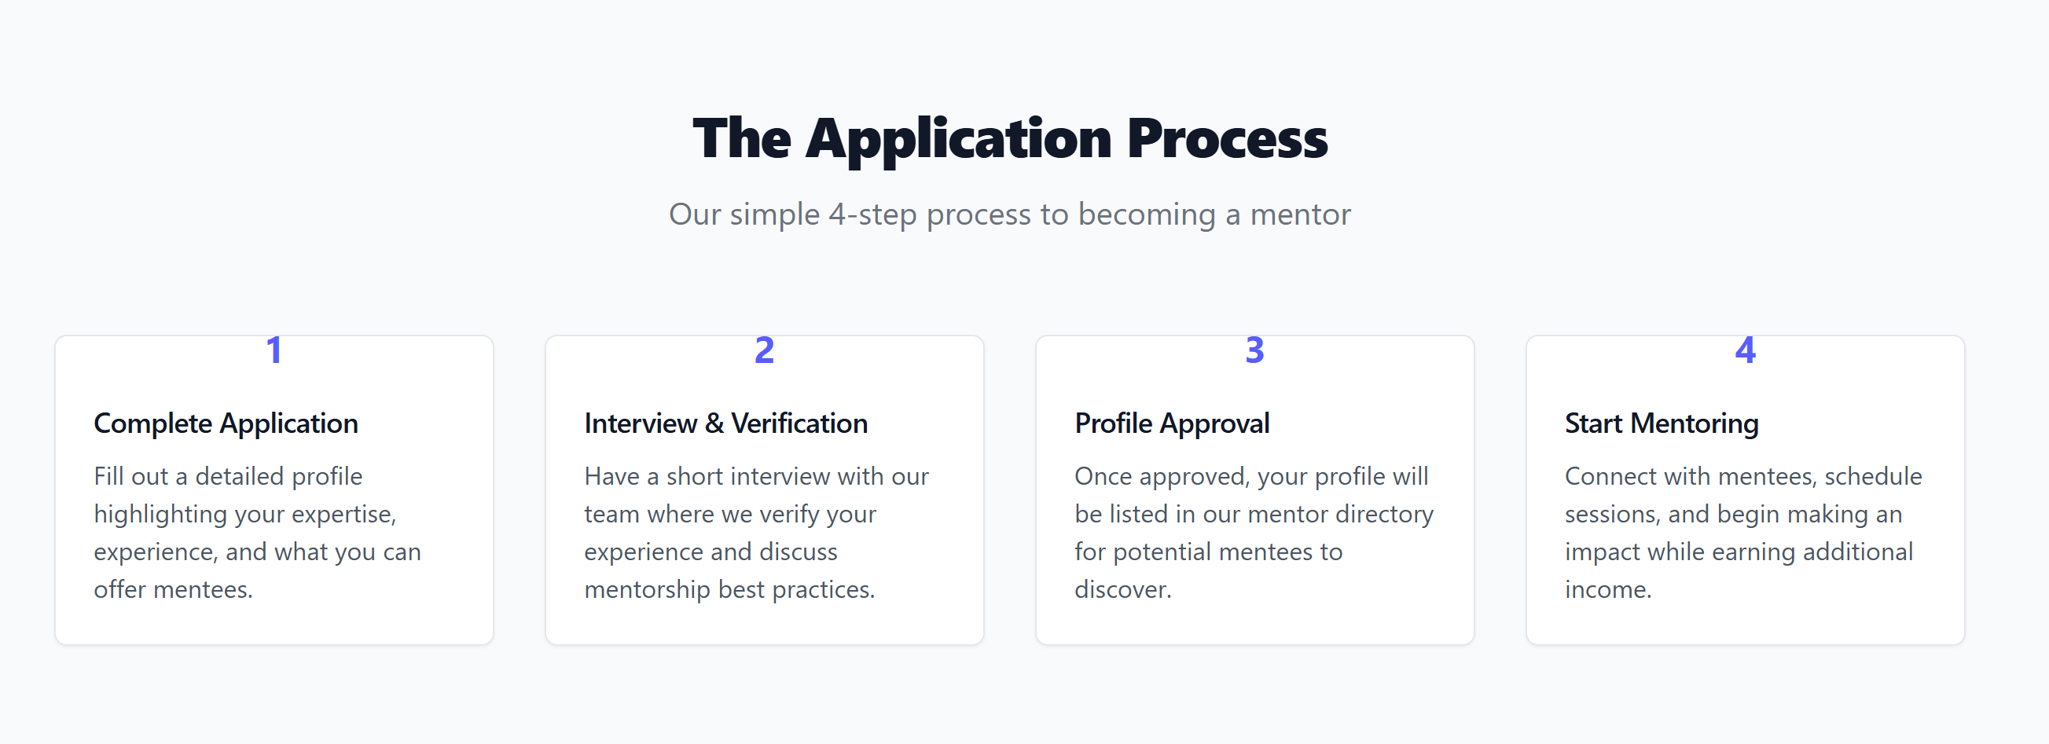
Results / Snapshots

Slide 13
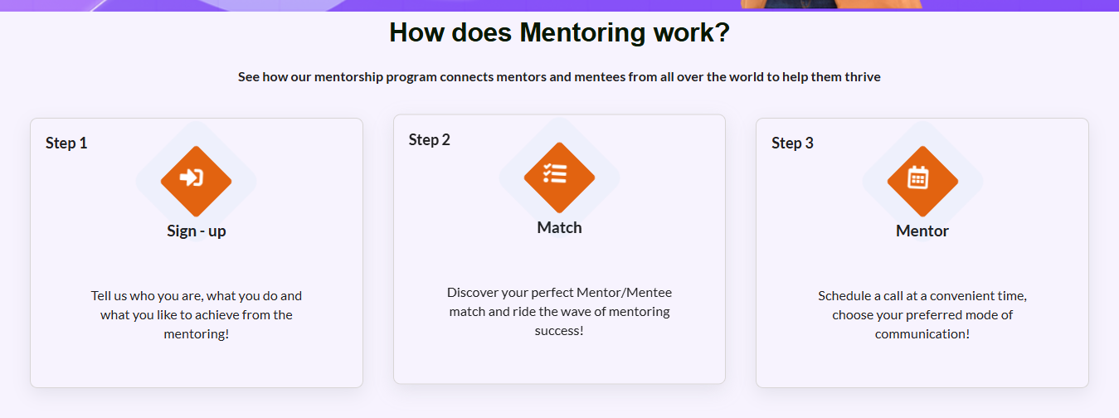
Results / Snapshots
Working Of Application

Slide 14
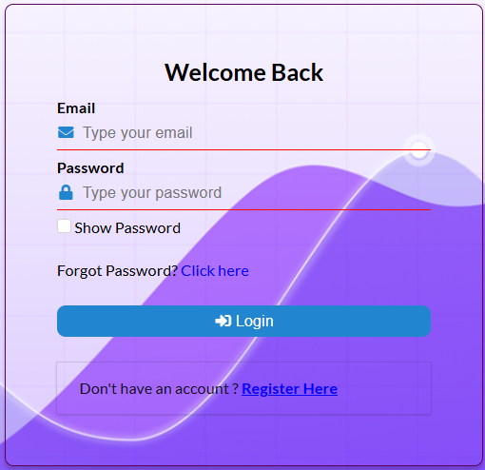
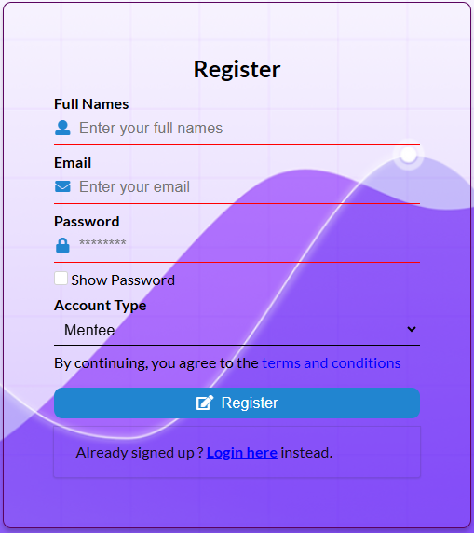
Results / Snapshots
Login
Registration
Login-Registration Pages

Slide 15
Future Scope and Advancement
1. AI-Powered Personalization
Intelligent mentor recommendations based on mentee profiles.
Real-time adaptive guidance using AI-driven insights.
2. Global Accessibility
Multilingual support to connect users worldwide.
Region-specific resources tailored to diverse audiences.
3. Advanced Communication Features
AR/VR-based sessions for immersive mentorship experiences.
Detailed analytics for enhanced feedback and session optimization.
4. Gamification and Rewards
Achievements, badges, and leaderboards to drive engagement.
Rewards for active participation and mentorship milestones.
5. Integration with Career Platforms
Partnerships with job boards and e-learning platforms for holistic career growth.

Slide 16
Limitations
Limited Integration:
While the platform provides basic appointment scheduling, it currently lacks integration with external calendars (e.g., Google Calendar or Outlook), which would make scheduling even more seamless.
Lack of AI-Driven Features:
The absence of AI-driven mentor recommendations or compatibility matching limits the ability of the platform to make automatic and intelligent suggestions, relying instead on manual search and filters.
Language and Localization:
The application currently supports only English. To reach a global audience, it would need to incorporate multilingual support to cater to users from diverse linguistic backgrounds.
No Native Mobile Application:
While the web application is responsive, a native mobile application would provide a better experience, especially for users accessing the platform on the go.

Slide 17
Conclusion
The Mentoring Web Application was developed to provide an efficient, user-friendly platform that connects mentors and mentees across various domains, addressing the growing need for guidance in personal and professional development. Built using the MERN stack (MongoDB, Express, React, Node.js) with secure JWT authentication, the system ensures scalability, responsiveness, and a smooth user experience.
The development followed a structured SDLC approach, covering all phases from planning to deployment. The frontend emphasized a responsive, intuitive design, while the backend managed session scheduling, real-time messaging, and authentication via RESTful APIs.
Overall, it demonstrates the power of modern web development in solving real-world mentorship challenges while providing hands-on experience in full-stack application development.

Slide 18
References
M. Brown, "A framework to guide an education response 2020", J. Prof. Capital Community, vol. 28, no. 2, pp. 2340-2350, 2020, [online] Available: https://oro.open.ac.uk/59302/7/ThesisFinalPapathoma_03.03.2019.pdf%0Ahttps://www.scielo.org.pe/pdf/pyr/v7n2/a21v7n2.pdf. Google Scholar
Steed, F. Orega and A. Williams, Evaluating Immersive Experiences During COVID-19 and Beyond | ACM Interactions, Jul. 2021, [online] Available: https://interactions.acm.org/blog/view/evaluating-immersive-experiences-during-covid-19-and-beyond. Google Scholar
https://en.unesco.org/news/covid-19-educational-disruption-and-response.
TheCrisis Response: Supporting Tertiary Education for Continuity Adaptation and Innovation,2020,[online]Available: https://pubdocs.worldbank.org/en/621991586463915490/WB-Tertiary-Ed-and-Covid-19-Crisis-for-public-use-April-9.pdf. Google Scholar
React Documentation. (2021). React - A JavaScript Library for Building User Interfaces. https://reactjs.org

